Slide 1
Data Structures Workshop
Day 13

Slide 2
Workshop Outline
Infix to Postfix Tracing (Could be on Exam 2)
Postfix Evaluation Tracing (Could be on Exam 2)
Queue Data Structures
Queues as Linked Lists Implementation
Priority Queues

Slide 3
Infix to Postfix Recap
Uses the stack data structure to convert an infix expression to a postfix one
Iterate through given string, if we find a operand, we output it
If we find an operator, we push to stack
Different cases for dealing with what already exists in stack, popping from it and so on, like mentioned last workshop!

Slide 4
Infix to Postfix Tracing Example
Given the following infix expression:
4+2/7*(8-3)^2
Convert it to postfix notation by hand.
Answer:
427/83-2^*+

Slide 5
Postfix Evaluation Recap
Uses the stack data structure to evaluate a postfix expression
Push operands into the stack
When we come across an operator, we pop the 2 topmost elements of the stack and apply said operator on those 2 values and push the result back into the stack

Slide 6
Postfix Evaluation Tracing
Evaluate the following postfix expression:
57+67+*
Answer:
156

Slide 7
Queues

Slide 8
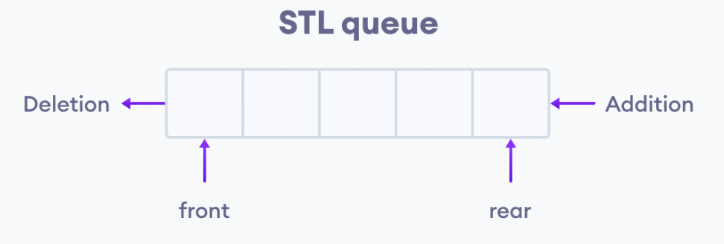
What is a Queue?
The queue data structure follows the “FIFO” (First In First Out) principle where elements that are added first will be removed first.
Inserting elements will add to the end of the queue, while removing elements will remove from the front of the queue, think of it as getting in line for something!
First come, first served!
Most commonly implemented using Linked Lists or the STL C++ Library

Slide 9
Implementing Queues as Linked Lists
Here are the different operations that we need to have to get the functionality of a queue:
push(value)/enqueue(value) → adds elements to the end of the queue
pop()/dequeue() → removes elements from the front of a queue
front() → returns whatever element is at the front of the queue
size() → returns size of the queue
isEmpty() → returns “true” if queue is empty

Slide 10
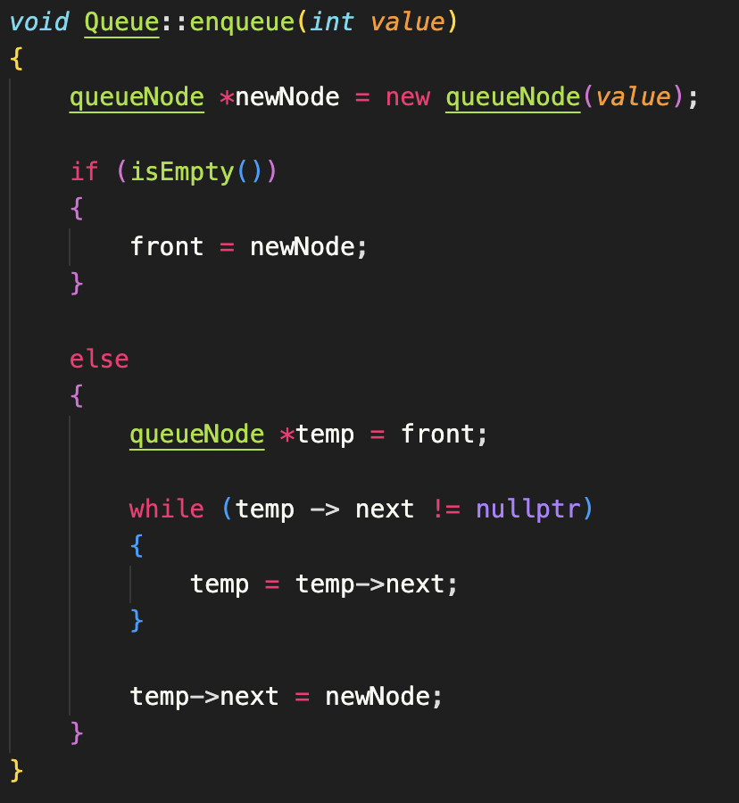
enqueue(val) Function
Idea: Add at end of the queue
Same as “addAtEnd()” function for Linked Lists!

Slide 11
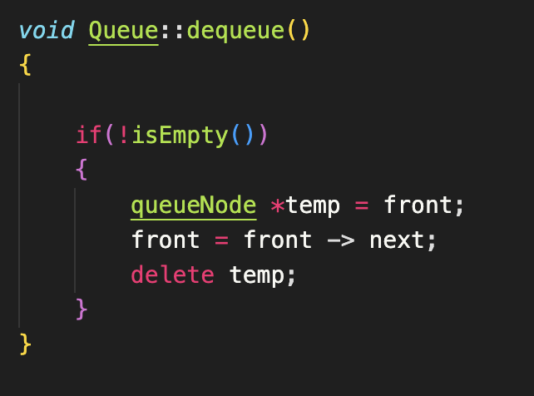
dequeue() Function
Idea: Remove at front of queue
Same as “deleteAtBeg()” function for Linked Lists!

Slide 12
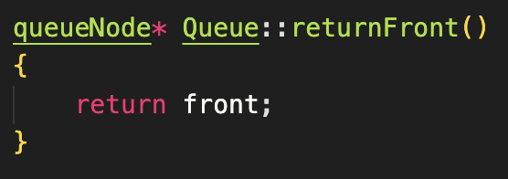
front() Function
Idea: Return whatever is at the front of the queue without dequeuing it
Our front pointer already holds whatever node is at the front of the queue, so return that

Slide 13
Priority Queues

Slide 14
Implementation
Priority Queues act the same as normal ones, except now the order of the queue is based on priority
Elements with a “higher” priority are put at the front of the queue
Elements with a “lower” priority are put at the end of the queue
Elements with the same priority are added to the queue based on which one was added first
Go hand in hand with heaps, which will be discussed later

Slide 15
Try Implementing Yourself!
Implement an enqueue() function that organizes the order of tasks based on their priority (higher priorities go in front of queue).
MS Teams will have sample code for you to use.
To compile and run on VSCode, you can run the following in your terminal:
g++ -std=c++11 -o run main.cpp prioQueue.cpp
Then, type in “./run” for it to execute

